Slide 1
Evaluation of Tri-training with conventional machine learning and deep learning algorithms and deep textual embeddings

Slide 2
Tri-training Algorithm
Proposed by Zhi-Hua Zhou and Ming Li in 2005, tri-training is an algorithm aiming to exploit unlabelled data by training three independent classifiers using different machine learning algorithm and bootstrap labelled training set upon each training epoch.
Compared to co-training:
1. Tri-training Algorithm does not require two sufficient and redundant view pf the same dataset.
2. Initial classifiers in tri-training should be diverse to offset the effect of the lack of two independent views.
3. When determining which unlabelled data can be labelled, tri-training does not require the explicitly measure the confidence by each classifier. As long as the other two classifiers agree on the labelling of a certain example, it can be labelled for another classifier.
4. The final hypothesis is produced via majority voting.
Enhancement from the original paper: The original paper only evaluated bi-class classification of data set. The same algorithm can be applied to classify text with multiple target labels.

Slide 3
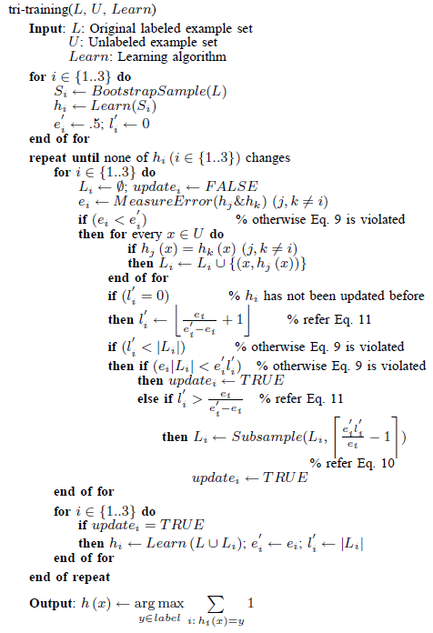
The tri-training algorithm
I have referred to the original paper to understand the algorithm on the right and had the general idea of how it works. The original deduction involved some mathematical content that was a bit hard for me to understand. I believe given some time I can re-create the algorithm and start evaluating the performances.

Slide 4
Available Document embeddings
TFIDF
Doc2Vec from Word2Vec
USE
BERT
ELMO
Not included by Zhiwei:
GloVe (can be used to embed documents)
Fasttext (a vector representation technique developed by facebook AI research and can derive word vectors for unknown words or out of vocabulary words)

Slide 5
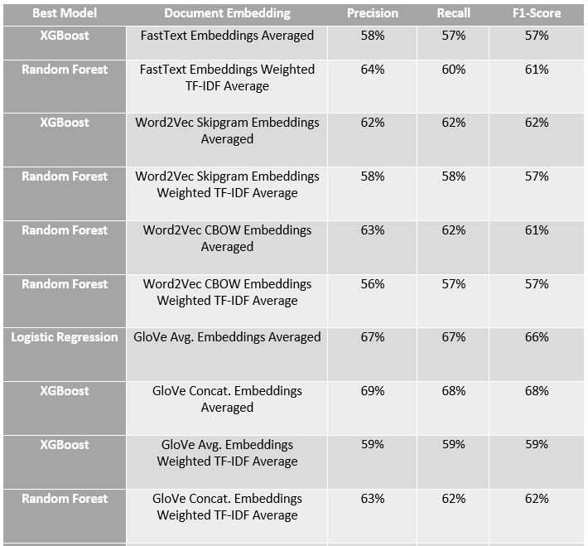
A possible improvement
A method to hybrid different types of document embeddings by averaging the vectors produced by them. The author intends to amplify the advantages of each embedding method.
An example from the source website
https://medium.com/analytics-vidhya/combining-word-embeddings-to-form-document-embeddings-9135a66ae0f

Slide 6
Available algorithms
SVM
MLP
RF
XGB
Not included by Zhi Wei
Naïve Bayesian
Another available improvement: neural network ensemble, and then introduce it to correct the mislabelled data
Since tri-training needs increase its diversity by using different learning algorithms, a combination of the above mentioned algorithms can be selected together with a document embedding to evaluate its performances.

Slide 7
Available Dataset
Preferably Ohsumed dataset since it’s the less explored one by Zhiwei.
Ohsumed dataset is highly unbalanced, meaning some labels might have very few examples. Mentioned by Zhiwei, upsampling or assigning classes with respective weights, which can potentially mitigate data imbalance problem.

Slide 8
Evaluation method
As mentioned in Available Algorithms, tri-training benefits from using different training algorithms. We can generate combinations of algorithms with one document embedding and evaluate the error rate of the initial hypothesis, the final hypothesis and the improvement.
Also the performance of the tri-training algorithm can be compared with co-training and self-training models. To generate the two independent and sufficient dataset for co-training, the original dataset can be randomly splitted into two equivalent data sets.
An example table is shown below:
Document Embedding | Algorithm combination | Error of Initial Hypothesis | Error of Final Hypothesis | Improvement
TFIDF | SVM+MLP+RF | .152 | .135 | 11.4%
 | SVM+RF+XGB
 | MLP+RF+XGB
Doc2Vec | SVM+MLP+RF
 | SVM+RF+XGB
 | …

Slide 9
Improvements that can be made
1. The performance of the tri-training model is often unstable because of the mislabelled examples. The original author proposed to use data-editing mechanisms to identify mislabelled examples. Also mentioned in previous slide, neural network ensemble can be used to identify and correct mislabelled examples.
2. Besides the proposed evaluation method, the evaluation metrics of “Precision, Recall and F1 score” adopted by Zhiwei can also be used.
3. Algorithms and document embeddings not included by Zhiwei can be experimented on and evaluated.

